Slide 1
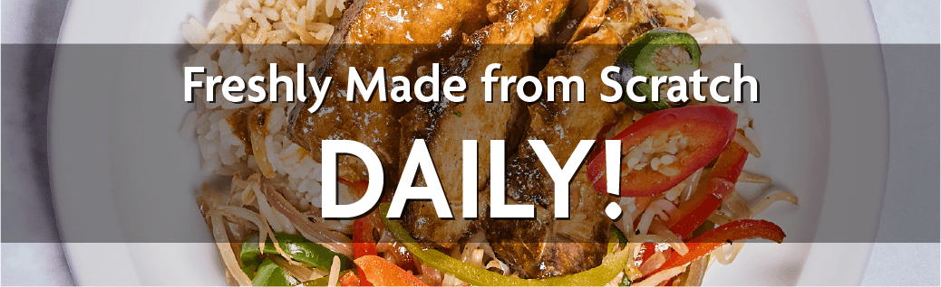

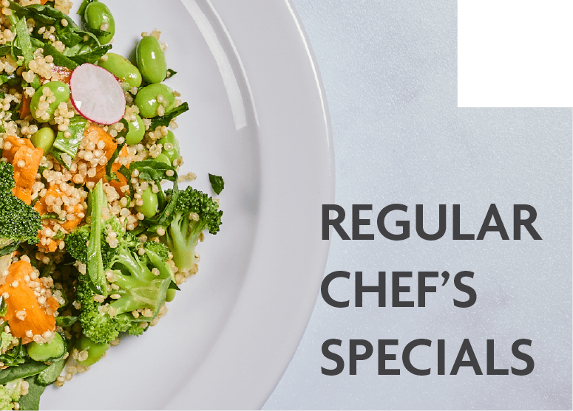
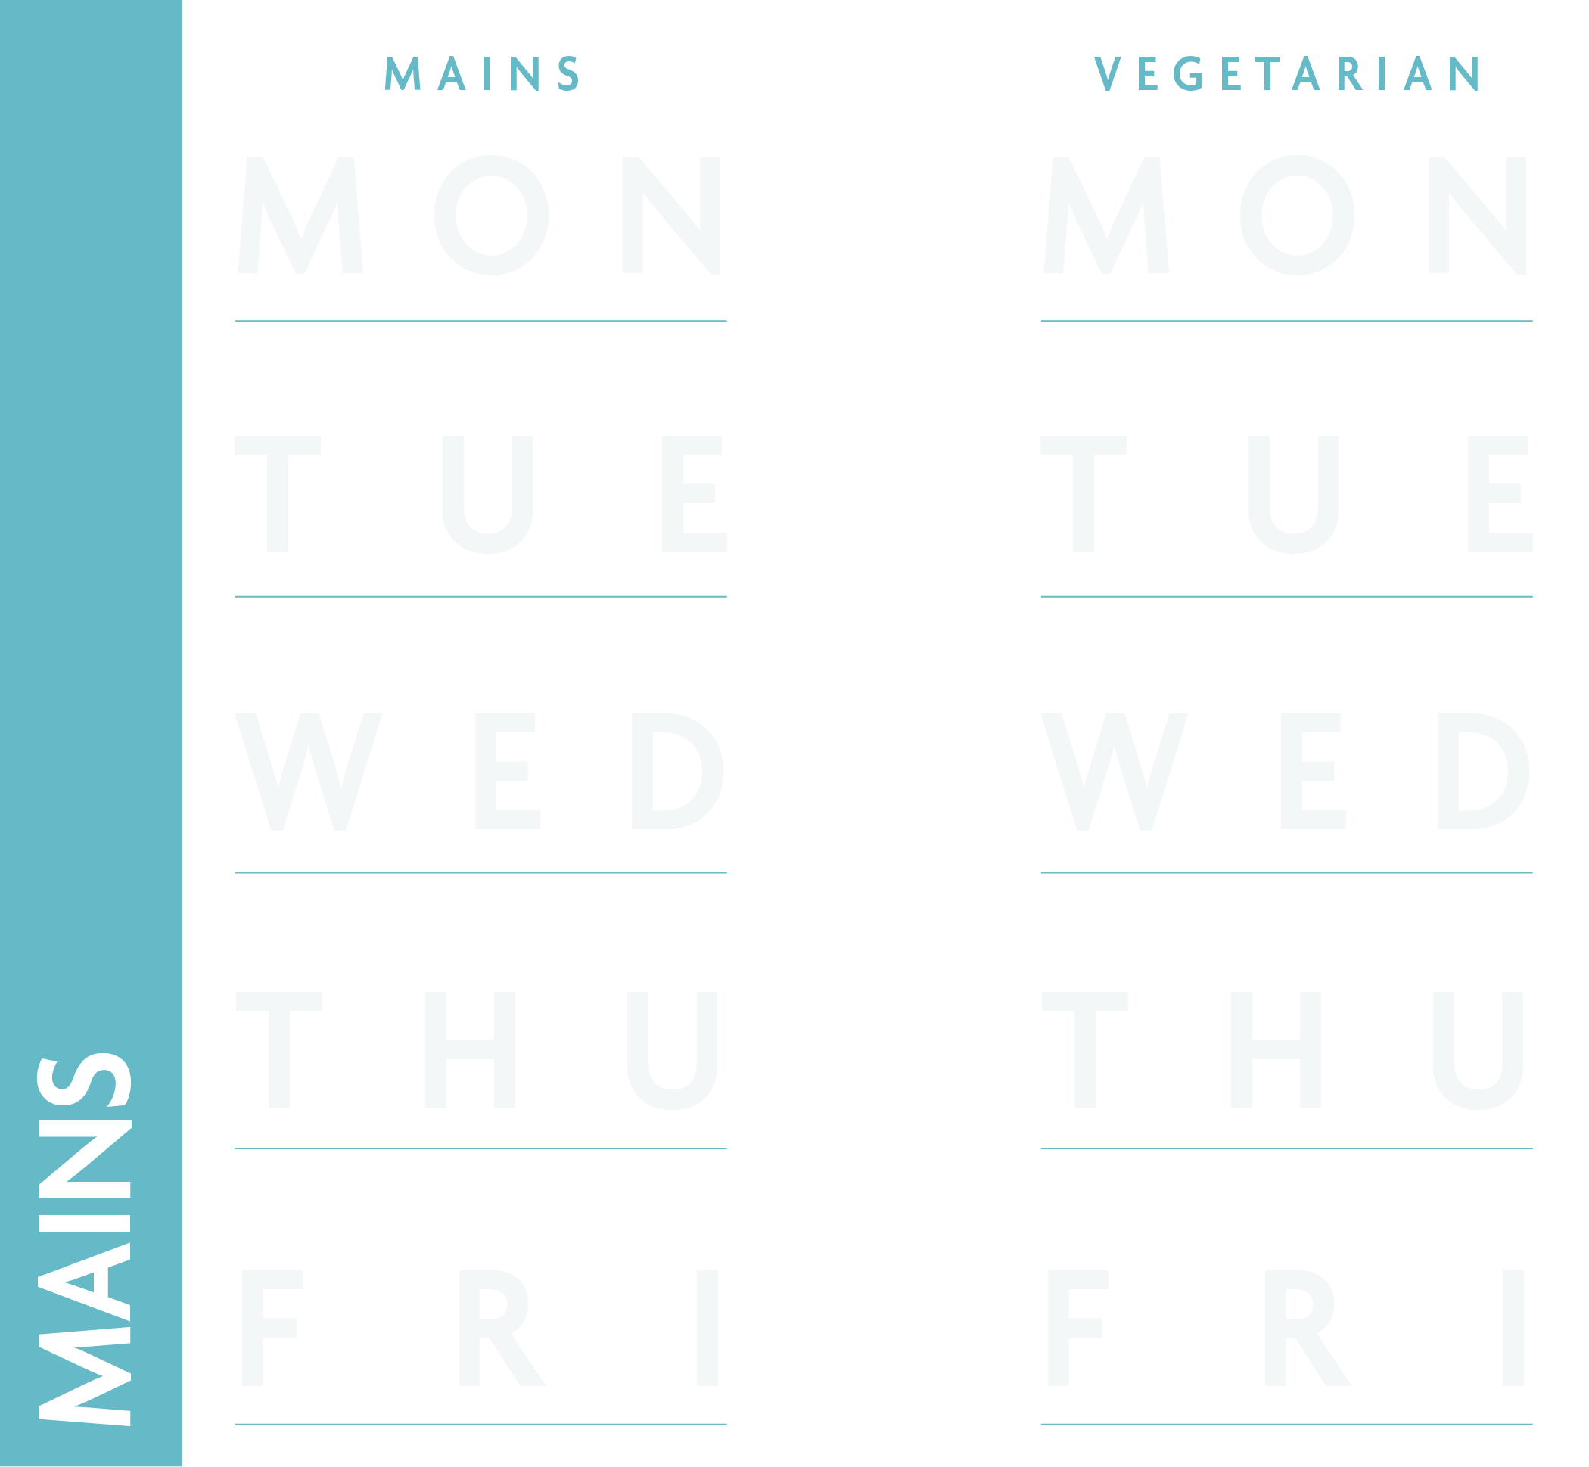














WEEK 1
Spring/Summer 2026
13/04/26, 04/05/26, 25/05/26, 15/06/26, 06/07/26, 27/07/26, 17/08/26, 07/09/26, 28/09/26, 19/10/26
ALL MAINS £2.10 INCLUDING VEGETABLES OR SALAD
THAI STYLE CHICKEN SATAY NUT FREE
SWEET & SPICY VEGETABLE STIR FRY
With COCONUT RICE
With COCONUT RICE
CREAMY CHICKEN CARBONARA STYLE LASAGNE
SUMMER VEGETABLE
& BASIL LASAGNE
CHICKEN SATAY NUT FREE
CHINESE CHICKEN
With HOMEMADE GARLIC FOCACCIA
With HOMEMADE GARLIC FOCACCIA
BOLOGNESE
ALL
THE CLASSICS
SWEET PINEAPPLE GLAZED GAMMON
CHEESY BUTTERNUT PUFF PASTRY SLICE
With HERBY SMASHED CRISPY
NEW POTATOES
With HERBY SMASHED CRISPY
NEW POTATOES
CHICKEN MADRAS with Naan Nachos & Mint Yoghurt
BUTTER CHICKPEA CURRY
with Naan Nachos & Mint Yoghurt
CHICKEN BURGER
£2.40
GERMAN STYLE DONER WRAP
£2.40
BEEF BURGER
£1.95
BURRITO
£2.30
LOADED CHIPS PEPPERONI MARINARA
£2.40
With YELLOW RICE
With YELLOW RICE
BATTERED FISH
SAUSAGE/VEG SAUSAGE
PIZZA SLICE
CHICKEN NUGGETS
PIZZA SLICE
VEGGIE SAUSAGE
TOMATO SAUCE & CHEESE
With CHIPS, GRAVY or IRISH CURRY SAUCE
With CHIPS, GRAVY or IRISH CURRY SAUCE
BEST EVER BOLOGNESE PASTA
CHICKEN KORMA RICE POT
BEST EVER BOLOGNESE PASTA
CHINESE CHICKEN CURRY NOODLES
CHICKEN KORMA RICE POT
ALL PASTA AND NOODLES £2.10
ASIAN STYLE VEGETABLES
HOUSE MIXED SALAD
ROASTED SUMMER VEGETABLES
KACHUMBER
SALAD
GARDEN PEAS OR BAKED BEANS
Boxed Salads
Boxed Salads
Boxed Salads
Boxed Salads
Boxed Salads
MEAL DEAL INCLUDES
MAIN OR JACKET OR PASTA WITH 1 TOPPING OR JUST SANDWICH + COOKIE OR WATER
Dessert of the Day
Dessert of the Day
Dessert of the Day
Dessert of the Day
Dessert of the Day
Fresh Cut Fruit & Yogurt Pots available daily

Slide 2



WEEK 2
Spring/Summer 2026
20/04/26, 11/05/26, 01/06/26, 22/06/26, 13/07/26, 03/08/26, 24/08/26, 14/09/26, 05/10/26
ALL MAINS £2.10 INCLUDING VEGETABLES OR SALAD
CAJUN CHICKEN LOADED
MAC CHEESE
with
Spicy BBQ Drizzle
CLASSIC BAKED MAC
with
Garlic Crispy Crumb
GREEK PORK SOUVLAKI FLATBREAD & TZATZIKI
TIROPITA
GREEK CHEESE FILO PIE
CAJUN CHICKEN
& SPICY
BBQ DRIZZLE
GREEK SOUVLAKI & TZATZIKI
With GREEK LEMON & OREGANO WEDGES
With GREEK LEMON & OREGANO WEDGES
HARISSA
LEMON TAGINE
TIKKA ROAST CHICKEN, CUMIN YORKIES & SPICED GRAVY
MASALA SPICED VEGGIE SAUSAGE,
CUMIN YORKIES & SPICED GRAVY
With MASALA ROASTIES
With MASALA ROASTIES
NORTH HARISSA LEMON CHICKEN TAGINE
EAST MISIR WOT ETHIOPIAN LENTIL STEW
CRISPY CHICKEN BURGER
£2.40
HOT CHICKEN WRAP
£2.40
ONE PAN BURRITO
£2.40
CHEESE & JALAPENO TOASTIE
£2.30
SOUTHERN CHICKEN WRAP
£2.70
With WEST TOMATO RICE
With WEST TOMATO RICE
BATTERED FISH
SAUSAGE/VEG SAUSAGE
PIZZA SLICE
CHICKEN NUGGETS
PIZZA SLICE
VEGGIE SAUSAGE
TOMATO SAUCE & CHEESE
With CHIPS, GRAVY or IRISH CURRY SAUCE
With CHIPS, GRAVY or IRISH CURRY SAUCE
SWEET & SOUR CHICKEN NOODLES
CHICKEN TIKKA MASALA RICE POT
SWEET & SOUR CHICKEN NOODLES
BEST EVER BOLOGNESE PASTA
CLASSIC
MAC CHEESE
ALL PASTA AND NOODLES £2.10
PEPPER LIME SLAW
MEDITERRANEAN SALAD
FRESH STEAMED GREENS
SOUTH
CHAKALAKA INSPIRED SALAD
GARDEN PEAS OR BAKED BEANS
Boxed Salad
Boxed Salad
Boxed Salad
Boxed Salad
Boxed Salad
MEAL DEAL INCLUDES
MAIN OR JACKET OR PASTA WITH 1 TOPPING OR JUST SANDWICH + COOKIE OR WATER
Dessert of the day
Dessert of the day
Dessert of the day
Dessert of the day
Dessert of the day
Fresh Cut Fruit & Yogurt Pots available daily

Slide 3





WEEK 3
Spring/Summer 2026
27/04/26, 18/05/26, 08/06/26, 29/06/26, 20/07/26, 10/08/26, 31/08/26, 21/09/26, 12/10/26
ALL MAINS £2.10 INCLUDING VEGETABLES OR SALAD
HOMEMADE SMOKY PORK
& RED ONION SAUSAGE ROLL
SMOKED CHEESE & ONION PASTY
With Potato Wedges
With Potato Wedges
CRISPY HONEY
SESAME CHICKEN
SWEET CHILLI AUBERGINE, MUSHROOM & EDAMAME
STIR FRY
MEATBALL MARINARA
SPICY CHICKEN
With Stir Fried Noodle & Beansprouts
With Stir Fried Noodle & Beansprouts
ALL
THE CLASSICS
SLOW ROAST PULLED GARLIC & THYME PORK WITH GRAVY
GARLIC & THYME
ROASTED VEGETABLE BEAN BAKE
With Skin on Roasties
With Skin on Roasties
SPICY MEXICANA BEEF
CORN TACOS
AVOCADO CREMA
SPICY BEAN
& CHEESE QUESADILLA
CRISPY CHICKEN WRAP
£2.70
SNACK
BEEF BURGER
£1.95
CHICKEN BURGER
£2.40
MARINATED CHICKEN WRAP
£2.40
BBQ CHEESE LOADED CHIPS
£2.30
With Steamed Rice
With Steamed Rice
BATTERED FISH
SAUSAGE/VEG SAUSAGE
PIZZA SLICE
CHICKEN NUGGETS
PIZZA SLICE
VEGGIE SAUSAGE
TOMATO SAUCE & CHEESE
With CHIPS, GRAVY or IRISH CURRY SAUCE
With CHIPS, GRAVY or IRISH CURRY SAUCE
MEATBALL MARINARA PASTA
BEAN CHILLI
RICE POT
SPICY
CHICKEN PASTA
BEST EVER BOLOGNESE PASTA
CLASSIC MAC CHEESE
ALL PASTA AND NOODLES £2.10
BBQ BAKED BEANS
ASIAN
GREENS
GREEN BEANS &
CARROTS
MEXICAN CHOPPED SALAD
GARDEN PEAS OR BAKED BEANS
Boxed Salad
Boxed Salad
Boxed Salad
Boxed Salad
Boxed Salad
MEAL DEAL INCLUDES
MAIN OR JACKET OR PASTA WITH 1 TOPPING OR JUST SANDWICH + COOKIE OR WATER
Dessert of the day
Dessert of the day
Dessert of the day
Dessert of the day
Dessert of the day
Fresh Cut Fruit & Yogurt Pots available daily

